Slide 1


The Pale Beyond
Rover Vos
Rover Vos 2023
Image – (Bellular Studios, 2023)

Slide 2


Slide 3
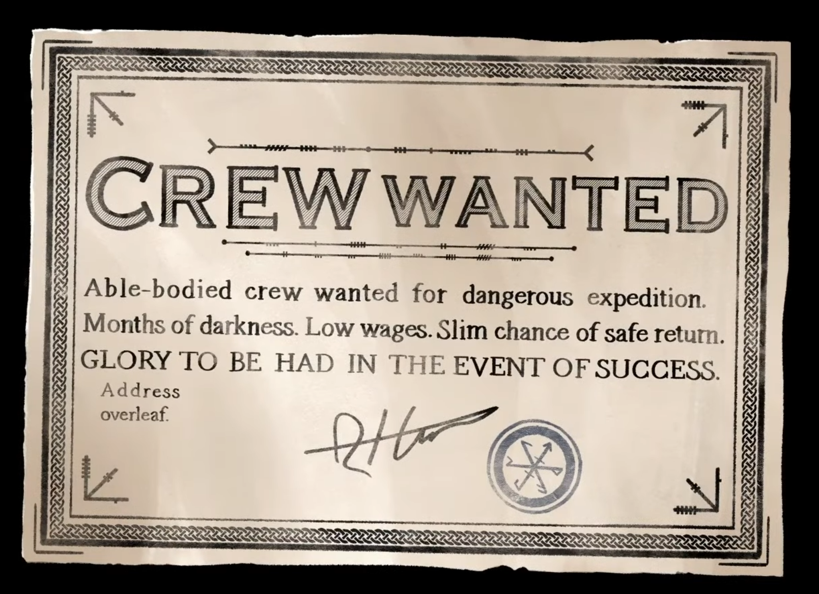
In game screenshot self-made

Slide 4
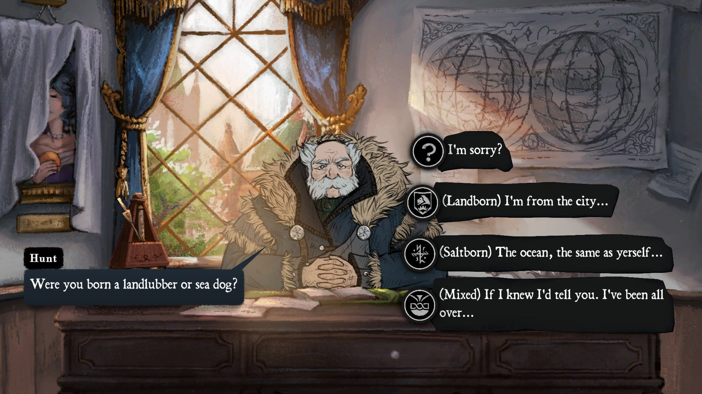
In game screenshot self-made

Slide 5

In game screenshot self-made

Slide 6

In game screenshot self-made

Slide 7

Robin Shaw?
In game screenshot self-made

Slide 8
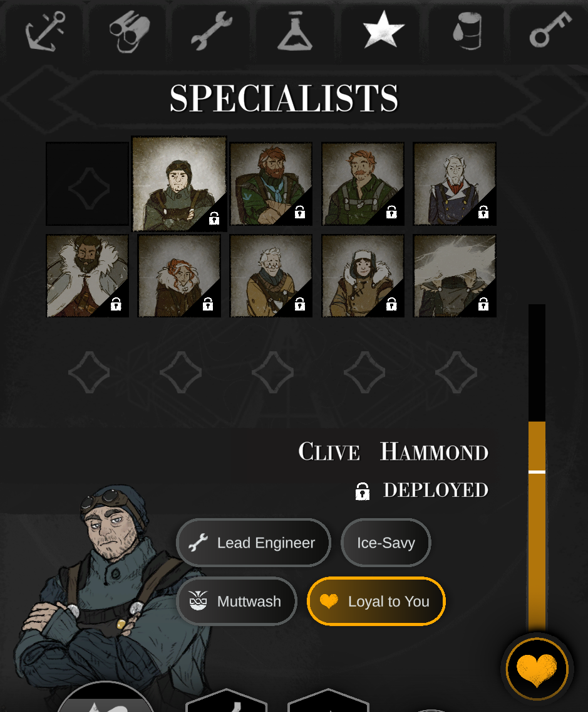
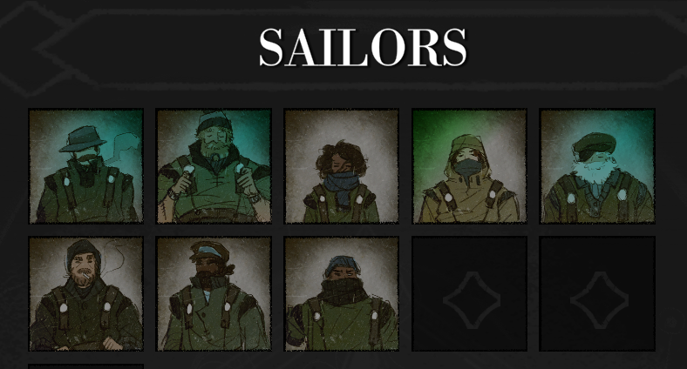



The crew
In game screenshots self-made

Slide 9
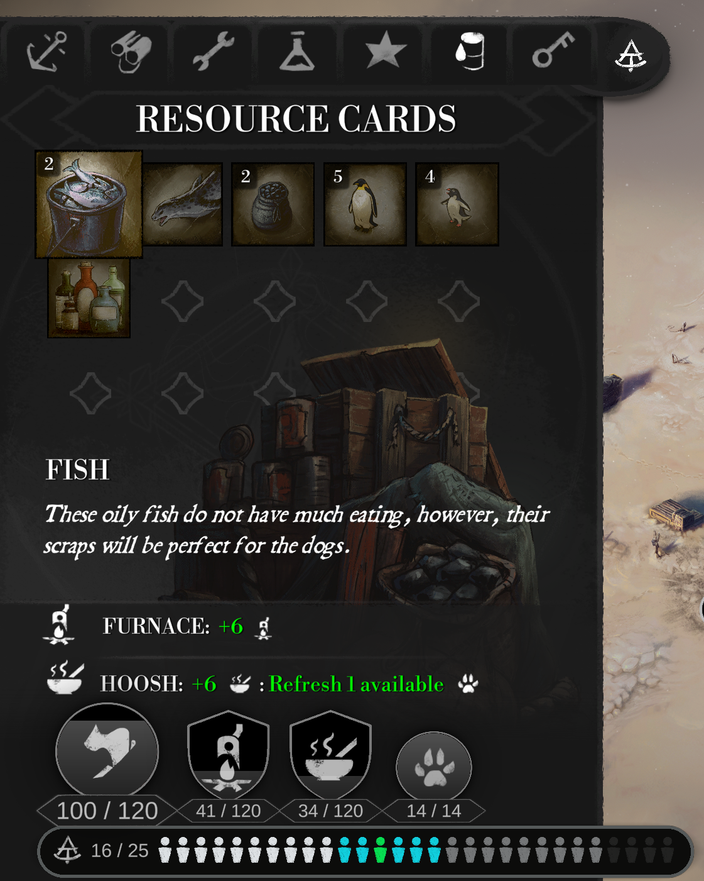
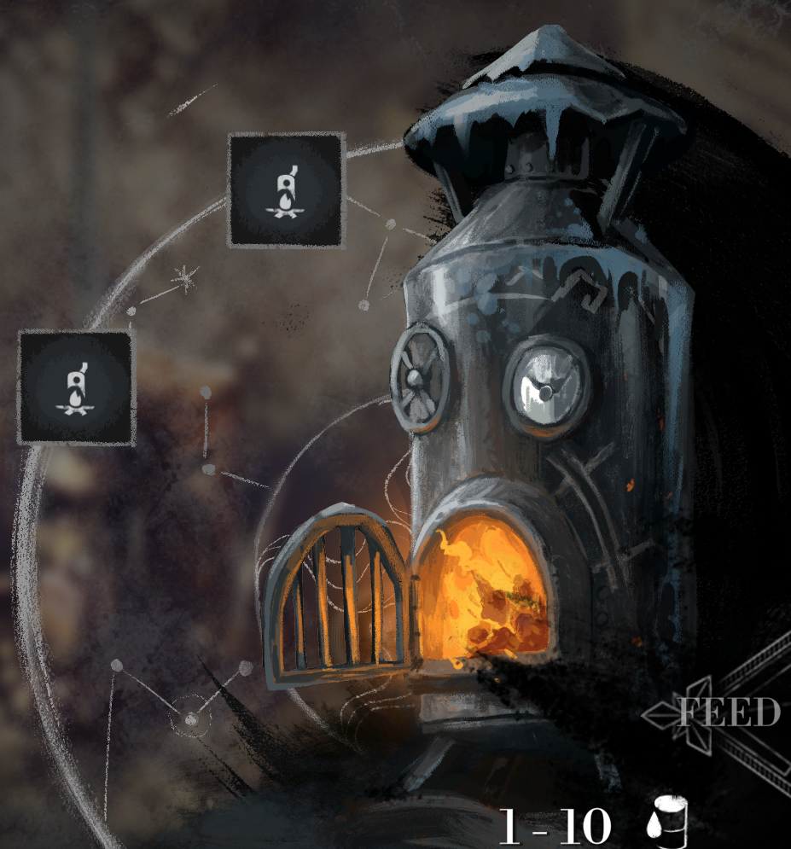
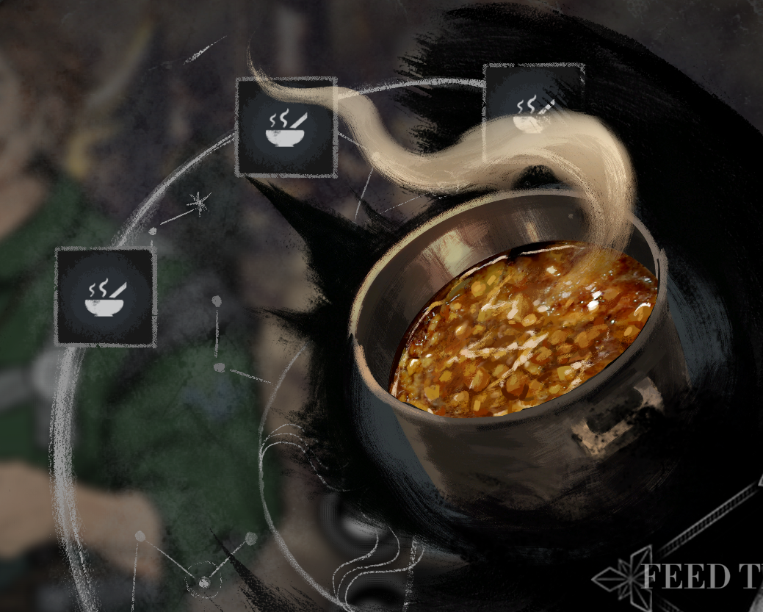
Resources
In game screenshots self-made

Slide 10
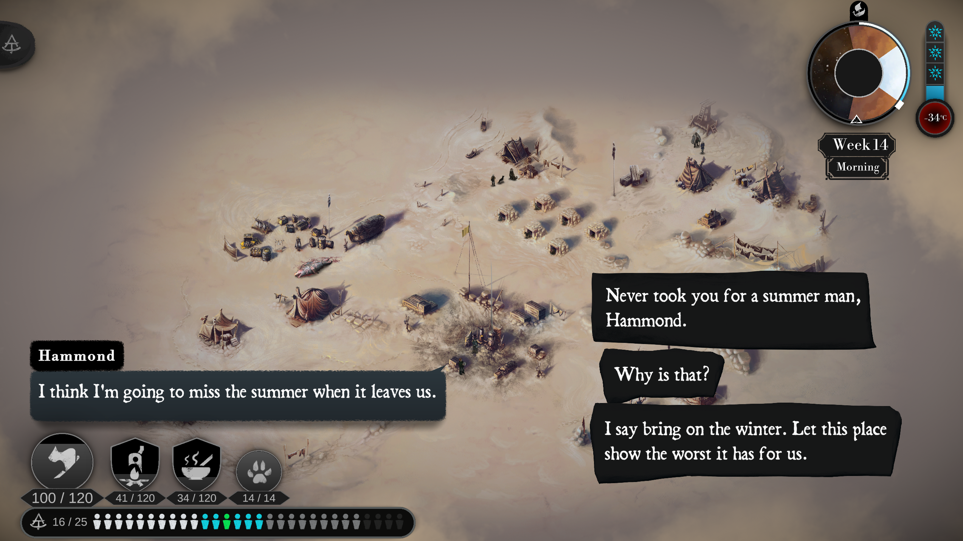
Importance of choice
IT MATTERS!
The response is specific and important
Positive
Negative
In game screenshot self-made

Slide 11
Ludonarrative resonance (Watssman 2012, n.p.)
As opposed to Ludonarrative dissonance (Hocking 2007, n.p.)

Slide 12
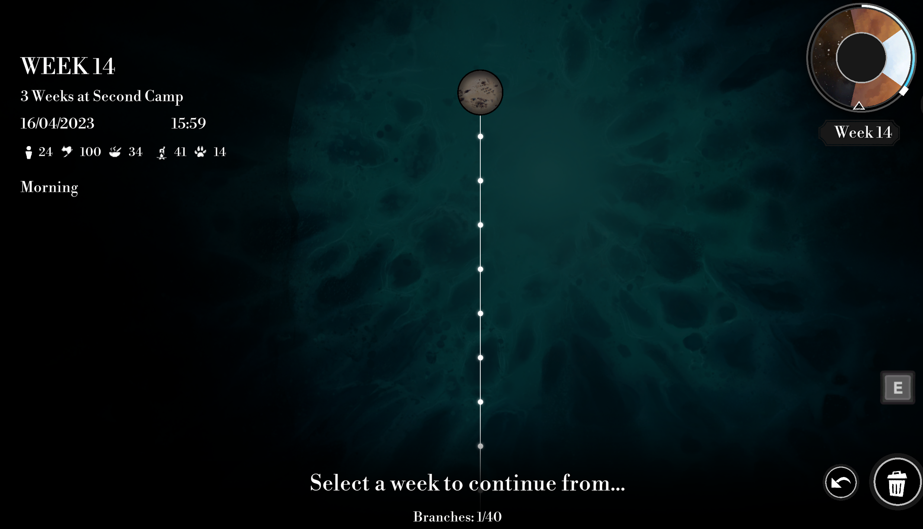
The save tree
In game screenshot self-made

Slide 13
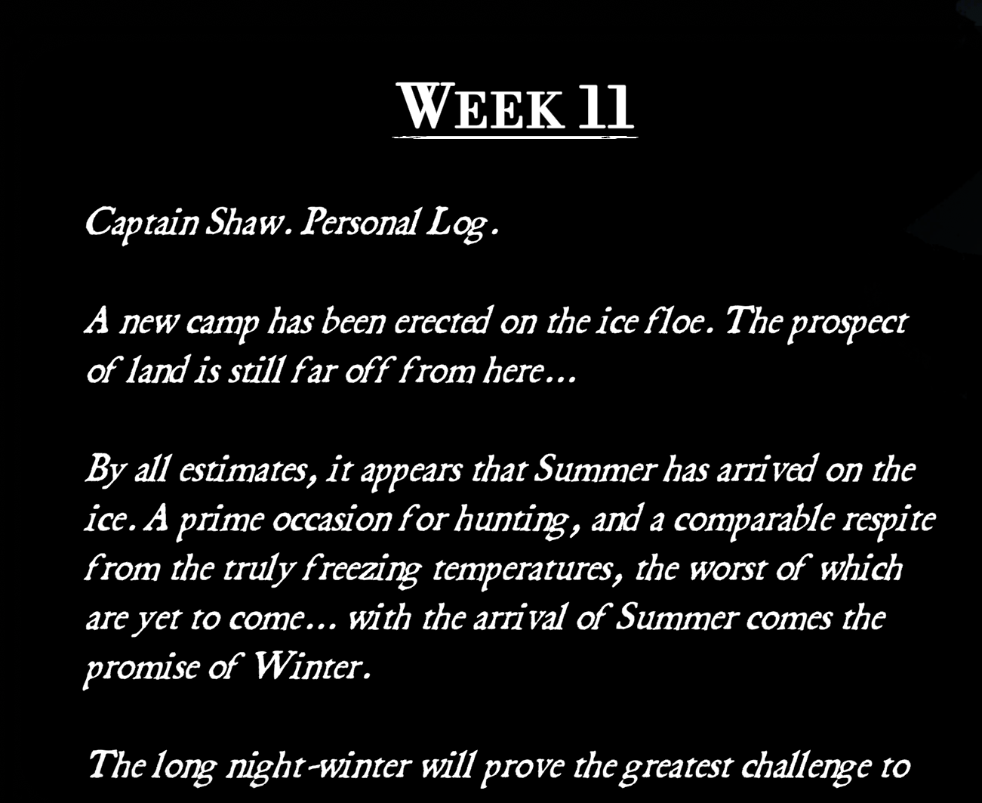
In game screenshot self-made

Slide 14
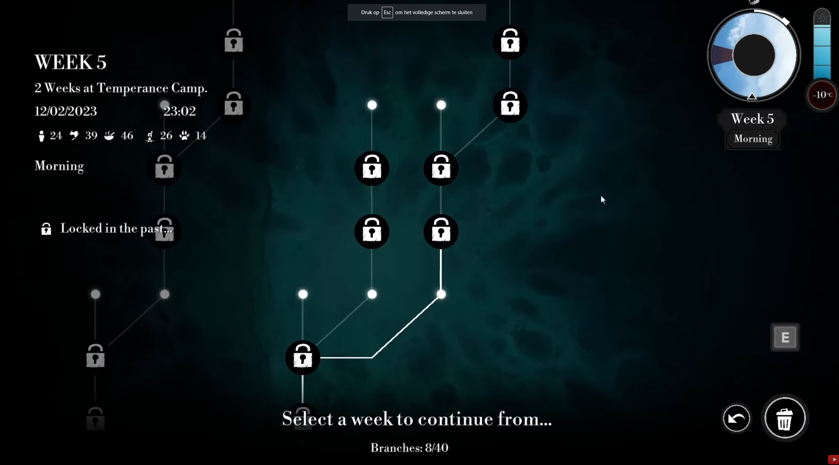
Screenshot from: https://www.youtube.com/watch?v=inFqwBFFIh4&t=269

Slide 15
Can a save system conceive a genre?

Slide 16
Could/should Ludonarrative resonance/ dissonance be a genre?

Slide 17
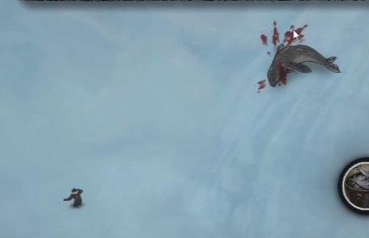
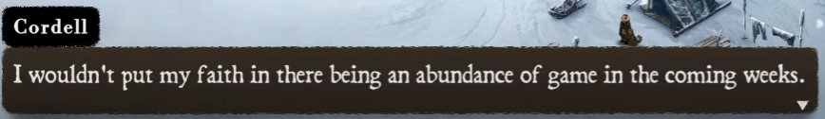
The world knows
35 weeks
12 weeks of reserve
In game screenshots self-made

Slide 18
Statement: The Pale Beyond is a puzzle

Slide 19
What genre(s(?)) do you think this game has?

Slide 20
Genre
Steam Publisher
Adventure
RPG
Strategy
Simulation
Indie

Slide 21
Indie genre?

Slide 22
Genre
Steam Publisher
Adventure
RPG
Strategy
Simulation
Indie
Reviewers
Adventure
Narrative
Survival
Simulation

Slide 23
Should The Pale Beyond be classified as a simulation game?

Slide 24
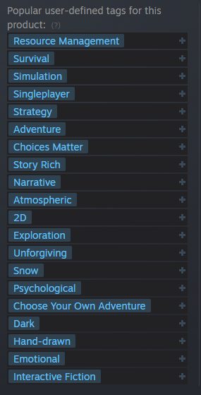
Genre
Steam Publisher
Adventure
RPG
Strategy
Simulation
Indie
Reviewers
Adventure
Narrative
Survival
Simulation
Genreverschmelzung
- (Beil, Benjamin, n.p.)
Screenshot Steam 19/4/23 The Pale Beyond tags

Slide 25
My preferred way of genre interpretation
“Genre’s provide an affective expectation off the experience of watching something unfold” – (Berlant 2011, 6)

Slide 26
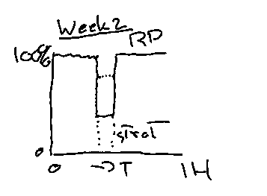
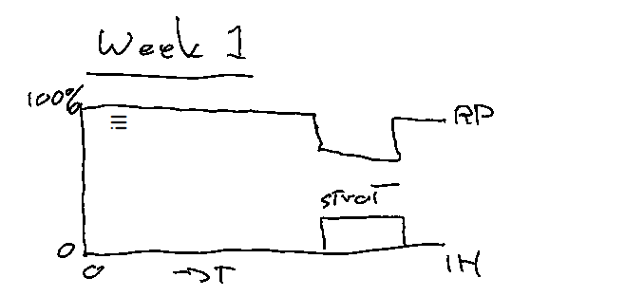
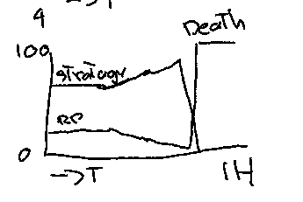
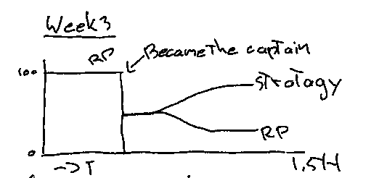
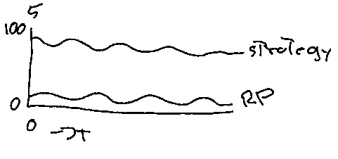

Slide 27
The Pale Beyond
Rover Vos
Image – (Bellular Studio 2023, n.p.)

Slide 28
Bibliography
Bellular Studios. 2019. The Pale Beyond. Belfast, Northern Ireland: Fellow Traveller.
Bellular Studios. 2023. The Pale Beyond Digital Artbook. Belfast, Northern Ireland: Fellow Traveller.
Beil, Benjamin. 2015. Game Studies und Genretheorie.
Berlant, Lauren. 2011. Cruel Optimism. Durham, North Carolina: Duke University Press Books
Despain, Wendy et al. 2009. Writing for Video Game Genres From FPS to RPG. Oxfordshire: Taylor & Francis
Hocking, Clint. “Ludonarrative Dissonance in Bioshock.” Click Nothing. accessed April 19. 2023 https://clicknothing.typepad.com/click_nothing/2007/10/ludonarrative-d.html
Watssman, Jeremy. “ESSAY: LUDONARRATIVE DISSONANCE EXPLAINED AND EXPANDED.” The Escapist Magazine accessed April 19. 2023 https://forums.escapistmagazine.com/threads/essay-ludonarrative-dissonance-explained-and-expanded.110491/

Slide 29
Reference note
Many concepts discussed during the presentation are from Writing for Video Game Genres From FPS to RPG. However the terms are not in this PowerPoint.
Look at chapter 2 (Writing for Role-Playing Games, Daniel Erickson), chapter 3 (Writing for Adventure Games, Lee Sheldon) and chapter 9 (Writing for Simulator Games, David Wessman).

